Slide 1
Unit 5
Generic programming

Slide 2
Introduction
Generics is the idea to allow type (Integer, String, … etc and user-defined types) to be a parameter to methods, classes and interfaces.
For example, classes like an array, map, etc, which can be used using generics very efficiently. We can use them for any type.
The method of Generic Programming is implemented to increase the efficiency of the code.
Generic Programming enables the programmer to write a general algorithm which will work with all data types.
It eliminates the need to create different algorithms if the data type is an integer, string or a character.
The advantages of Generic Programming are
Code Reusability
Avoid Function Overloading
Once written it can be used for multiple times and cases.

Slide 3
Generics can be implemented in C++ using Templates.
Template is a simple and yet very powerful tool in C++.
The simple idea is to pass data type as a parameter so that we don’t need to write the same code for different data types.
For example, a software company may need sort() for different data types. Rather than writing and maintaining the multiple codes, we can write one sort() and pass data type as a parameter.

Slide 4
Template in C++:
A features which provide us a generic function and generic class
It represents in two ways:
Function template
Class template

Slide 5
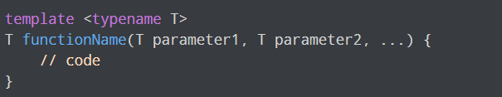
Function template
We can define a template for a function.
Generic functions use the concept of a function template.
The type of the data that the function will define it depends up on the type of the data passed as a parameter.
It is created by using the keyword template
Syntax:
class or typename

Slide 6
Defining a Function Template
T is a template argument that accepts different data types (int, float, etc.), and typename is a keyword.
A function template starts with the keyword template followed by template parameter(s) inside <>
T is a template argument that accepts different data types (int, float, etc.), and typename is a keyword
When an argument of a data type is passed to functionName(), the compiler generates a new version of functionName() for the given data type.

Slide 7

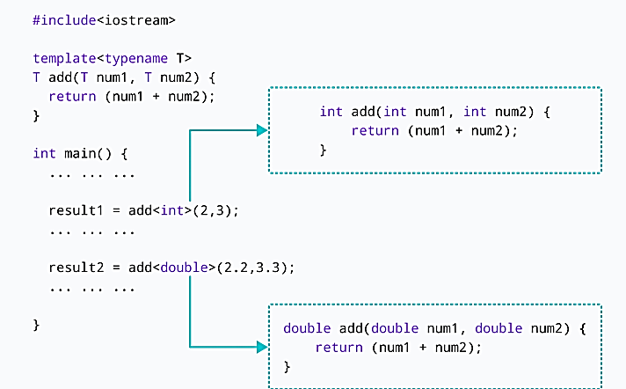
Calling a Function Template

Slide 8
#include <iostream>
using namespace std;
template <typename T>
T add(T num1, T num2) {
return (num1 + num2);
}
int main() {
int result1;
double result2;
// calling with int parameters
result1 = add<int>(2, 3);
cout << "2 + 3 = " << result1 << endl;
// calling with double parameters
result2 = add<double>(2.2, 3.3);
cout << "2.2 + 3.3 = " << result2 << endl;
return 0;
}

Slide 9
#include <iostream>
using namespace std;
// One function works for all data types.
template <typename T>
T myMax(T x, T y)
{
return (x > y) ? x : y;
}
int main()
{
// Call myMax for int
cout << myMax<int>(3, 7) << endl;
// call myMax for double
cout << myMax<double>(3.0, 7.0) << endl;
// call myMax for char
cout << myMax<char>('g', 'e') << endl;
return 0;
}

Slide 10
#include <iostream>
using namespace std;
template <class T> void bubbleSort(T a[], int n)
{
for (int i = 0; i < n - 1; i++)
for (int j = n - 1; i < j; j--)
if (a[j] < a[j - 1])
swap(a[j], a[j - 1]);
}
int main()
{
int a[5] = { 10, 50, 30, 40, 20 };
int n = sizeof(a) / sizeof(a[0]);
// calls template function
bubbleSort<int>(a, n);
cout << " Sorted array : ";
for (int i = 0; i < n; i++)
cout << a[i] << " ";
cout << endl;
return 0;
}

Slide 11
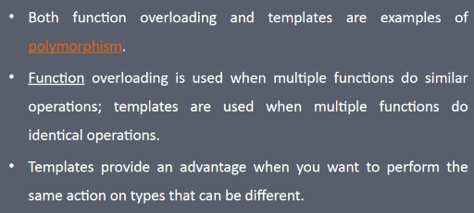
Function overloading v/s function template

Slide 12
Function overloading v/s function template
overloading is used when we have various functions , doing SIMILAR operations .
template is used when we have various functions , doing IDENTICAL operations .
There is very big differnce between "SIMILAR" and "IDENTICAL".

Slide 13
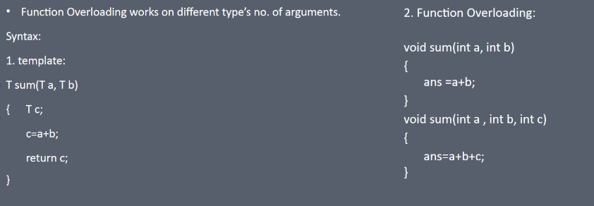

Slide 14
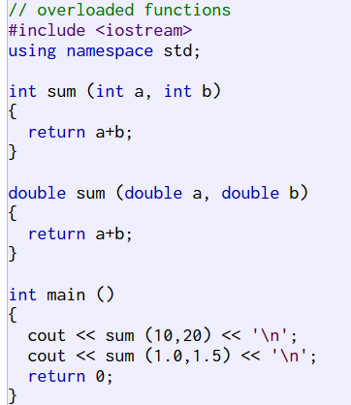
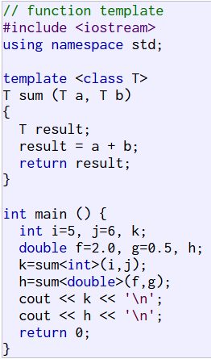

Slide 15
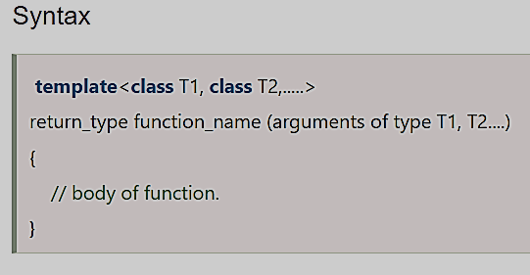
Function Templates with Multiple Parameters

Slide 16
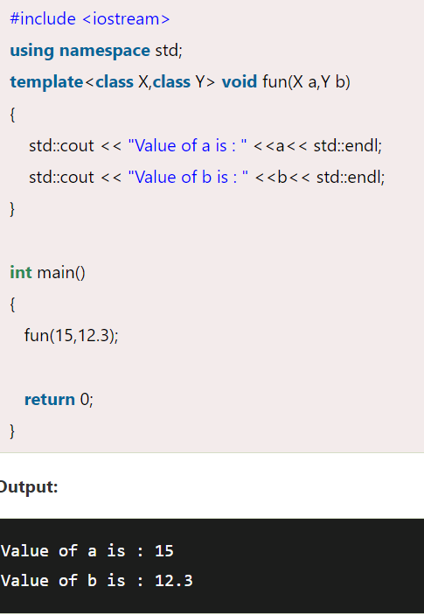

Slide 17
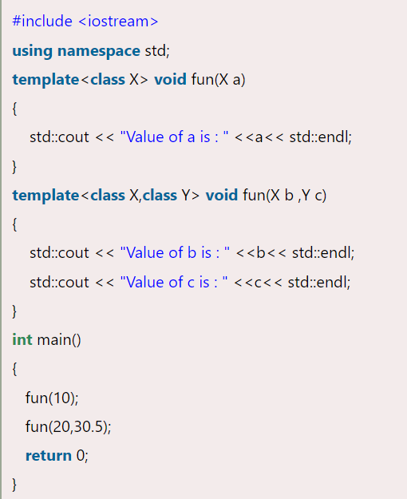
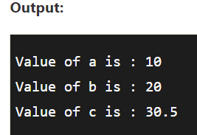
Overloading a Function Template

Slide 18
recursion with template function
The process in which a function call by itself is called recursion and the corresponding function is called as recursive function.
We can create recursive template function
Example:

Slide 19
#include <iostream.h>
using namespace std;
template<class T>
T sum(T arr[], int start, int len)
{
if(start >= len)
return 0;
return (arr[start] +
sum(arr, start + 1, len));
}
int main()
{
int arr1[] = {11,22,32,42,52};
double arr2[] = {1.1,1.2,1.3,1.4,1.5};
float arr3[]={12.3f,11.1f,11.3f,12.2f,13.1f};
cout<<sum(arr1,4,0)<<endl;
cout<<sum(arr2,0,3)<<endl;
cout<<sum(arr3,0,2)<<endl;
return 0;
}

Slide 20
Restrictions of Generic Functions
Generic functions perform the same operation for all the different data type.
For example If function is performing addition then it will perform addition only it will not perform subtraction, multiplication etc.…
There is the difference between function overloading and function template.

Slide 21
Which keyword can be used in template? a) class b) typename c) both class & typename d) function

Slide 22
Class Template

Slide 23
Class Template
Class Template can also be defined similarly to the Function Template. When a class uses the concept of Template, then the class is known as generic class

Slide 24
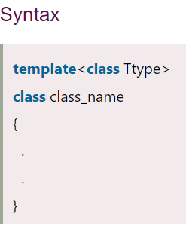
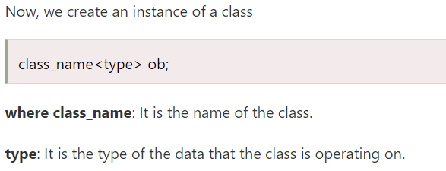

Slide 25
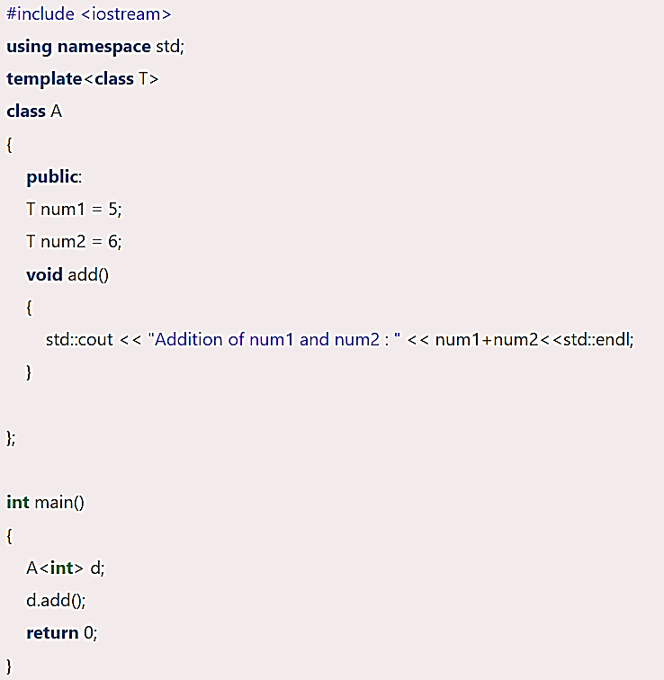
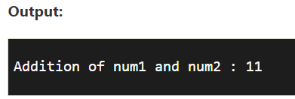

Slide 26
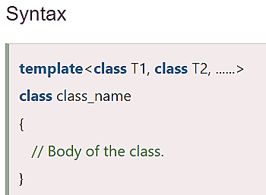
CLASS TEMPLATE WITH MULTIPLE PARAMETERS

Slide 27
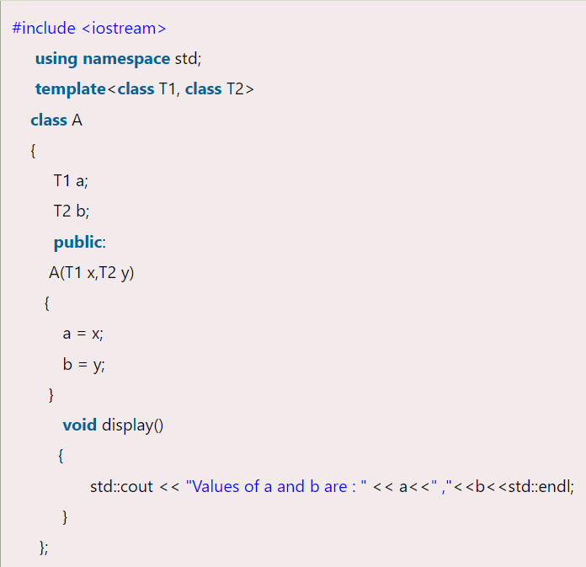
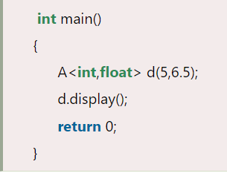
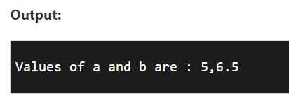

Slide 28
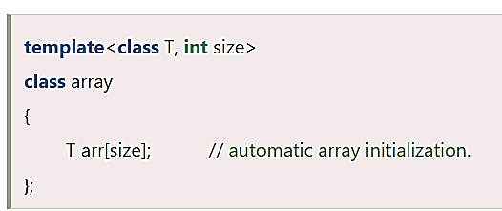
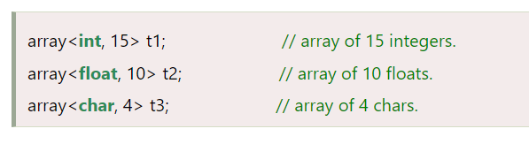
Nontype Template Arguments

Slide 29
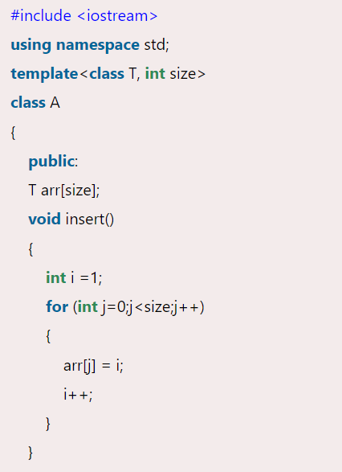
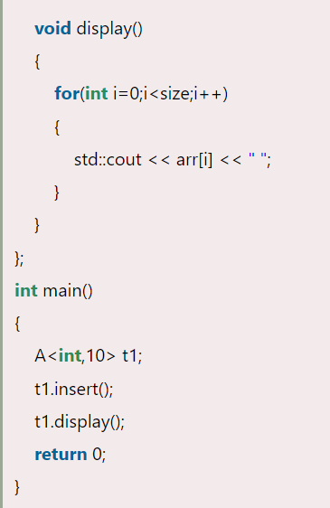
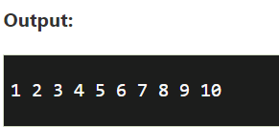

Slide 30
class template and inheritance:
template to template
B. template to class

Slide 31
Template Class to derived class
template<class T,int arraySize>
class arrayList
{
protected:
T num[arraySize];
T sum;
void add(T n[])
{
sum=0;
for(int i=0;i<arraySize;i++)
{
num[i]=n[i];
sum=sum+num[i];
}
cout<<"Sum of array elements are:"<<sum<<endl;
}
void disp()
{ cout<<"Array Elements are:"<<endl;
for(int i=0;i<arraySize;i++)
{
cout<<num[i]<<endl;
}
}
};
class derive: public arrayList<float,5>
{
public:
void MyParentFunction()
{
float num[]={11.1,2.1,1.1,4.1,6.1};
add(num);
disp();
}
};
int main()
{
derive d1;
d1.MyParentFunction();
return 0;
}

Slide 32
template<class T,int arraySize>
class arrayList
{
public:
T num[arraySize];
void add(T n[])
{
for(int i=0;i<arraySize;i++)
{
num[i]=n[i];
}
}
void disp()
{
cout<<"Array Elements are:"<<endl;
for(int i=0;i<arraySize;i++)
{
cout<<num[i]<<endl;
}
}
};
template<class T>
class sortedArray:public arrayList<int,5>
{
public:
void sorting(T n1[])
{
int temp;
int i,j;
for(i=0;i<5;i++)
{ for(j=i+1;j<5;j++)
{ if(n1[i]>n1[j])
{
temp=n1[i];
n1[i]=n1[j];
n1[j]=temp;
} } }
cout<<"Sorted Elements are:"<<endl;
for(int i=0;i<5;i++)
{
cout<<n1[i]<<endl;
}
}
};

Slide 33
int main()
{
int arr[5]={11,2,1,4,6};
sortedArray<int> s1;
s1.add(arr);
s1.disp();
s1.sorting(arr);
return 0;
}

Slide 34
Points to Remember
C++ supports a powerful feature known as a template to implement the concept of generic programming.
A template allows us to create a family of classes or family of functions to handle different data types.
Template classes and functions eliminate the code duplication of different data types and thus makes the development easier and faster.
Multiple parameters can be used in both class and function template.
Template functions can also be overloaded.
We can also use nontype arguments such as built-in or derived data types as template arguments.

Slide 35
Which statement is correct about function template?
Statement1:Function template also can be overload
Statement2:We can create recursive template function
Statement1 is correct
Statement2 is correct
both Statements are correct
None

Slide 36
What is the output of this program?
#include <iostream>
using namespace std;
template<class T>
class A
{
public:
func(T a,T b){return a+b;}
};
int main()
{
A <int>a1;
cout<<a1.func(3,2);
return 0;
}
5
Compilation Error
Nothing will print
None

Slide 37
Which statement is correct about template class?
Statement1:One normal class inheriting template class
Statement2:One template class inheriting other template class
Statement1 is correct
Statement2 is correct
both Statements are correct
None

Slide 38
What will be the output of the following C++ code?
#include <iostream>
using namespace std;
template <class type>
class Test
{
public:
type Funct1(type Var1)
{
return Var1;
}
type Funct2(type Var2)
{
return Var2;
}
};
int main()
{
Test<int> Var1;
Test<double> Var2;
cout << Var1.Funct1(200);
cout << Var2.Funct2(3.123);
return 0;
}
a) 100
b) 200
c) 3.123
d) 2003.123

Slide 39
What will be the output of the following C++ code?
#include <iostream>
using namespace std;
template <class type>
class Test
{
public:
Test() { };
~Test() {
};
type Funct1(type Var1)
{
return Var1;
}
};
int main()
{
Test<int> Var1;
cout << Var1.Funct1(200);
return 0;
}
a) 100
b) 200
c) 3.123
d) 2003.123

Slide 40
What will be output?
#include <iostream>
using namespace std;
template<class T>
class A
{
public:
T func(T a, T b){
return a/b;
}
};
int main()
{
A <int>a1;
cout<<a1.func(3,2);
cout<<a1.func(3.0,2.0);
return 0;
}
11
12
10
Error

Slide 41
Can we specify default value for template arguments? Yes, like normal parameters, we can specify default arguments to templates.

Slide 42
template<class T1, class T2 = char>
class A {
public:
T1 x;
T2 y;
A() { cout<<"Constructor Called"<<endl; }
};

Slide 43
What will be out put?
#include <iostream>
using namespace std;
template<class T>
class A
{
public:
A(){
cout<<"Created";
}
~A(){
cout<<"Destroyed";
}
};
int main()
{
A a;
return 0;
}
A: Created
B. Destroyed
C. CreatedDestroyed
D. Compilation Error

Slide 44
What will be out put?
#include <iostream>
using namespace std;
template<class T>
class A
{
public:
A(){
cout<<"Created";
}
~A(){
cout<<"Destroyed";
}
};
int main()
{
A <int>a;
return 0;
}
A: Created
B. Destroyed
C. CreatedDestroyed
D. Compilation Error

Slide 45
Macros
Macro is a preprocessor statement
Preprocessors are programs that process our source code before compilation.
A macro is a piece of code in a program that is replaced by the value of the macro.
Macro is defined by #define directive.
Whenever a macro name is encountered by the compiler, it replaces the name with the definition of the macro.
Macro definitions need not be terminated by a semi-colon(;).
The preprocessors statements means a instructions to the compiler to preprocess the information before actual compilation starts.
All preprocessor statement begin with #
There are number of preprocessor statements like #include, #define, #if, #else, #line, etc.
The #define preprocessor statement creates symbolic constants. The symbolic constant is called a macro
syntax:
#define macro-name replacement-text

Slide 46
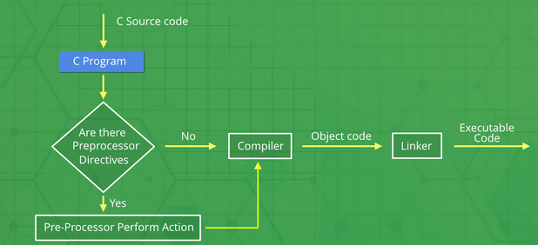
// C program to illustrate macros
#include <iostream.h>
// Macro definition
#define LIMIT 5
// Driver Code
int main()
{
// Print the value of macro defined
cout<<“The value of LIMIT is “<<LIMIT);
return 0;
}

Slide 47
// C program to illustrate macros
#include <iostream.h>
// Macro definition
#define AREA(l, b) (l * b)
// Driver Code
int main()
{
// Given lengths l1 and l2
int l1 = 10, l2 = 5, area;
// Find the area using macros
area = AREA(l1, l2);
// Print the area
cout<<"Area of rectangle is”<< area);
return 0;
}

Slide 48
Macro
No longer
No repetition
Define in short

Slide 49
Types Of Macros
Object-like Macros
Chain Macros
Multi-line Macros
Function-like Macro

Slide 50
Object like macro
An object-like macro is a simple identifier that will be replaced by a code fragment.
It is called object-like because it looks like an object in code that uses it.
It is popularly used to replace a symbolic name with numerical/variable represented as constant.
#include <stdio.h>
// Macro definition
#define DATE 31
// Driver Code
int main()
{
// Print the message
cout<<"Lockdown will be extended upto<<DATE<<-MAY-2020";
return 0;
}

Slide 51
Chain Macros
Macros inside macros are termed as chain macros.
In chain macros first of all parent macro is expanded then the child macro is expanded.
#include <iostream.h>
// Macro definition
#define INSTAGRAM FOLLOWERS
#define FOLLOWERS 138
// Driver Code
int main()
{
// Print the message
cout<<“It has ”<<INSTAGRAM<<“K followers on Instagram";
return 0;
}

Slide 52
Multi-line Macros
An object-like macro could have a multi-line.
So to create a multi-line macro you have to use backslash-newline.
#include <stdio.h>
// Multi-line Macro definition
#define ELE 1, \
2, \
3
int main()
{
// defined in macros
int arr[] = { ELE };
printf("Elements of Array are:\n"); // Print elements
for (int i = 0; i < 3; i++) {
printf("%d ", arr[i]);
}
return 0;
}

Slide 53
Function-like Macro:
These macros are the same as a function call.
It replaces the entire code instead of a function name.
Pair of parentheses immediately after the macro name is necessary.
If we put a space between the macro name and the parentheses in the macro definition, then the macro will not work. A function-like macro is only lengthened if and only if its name appears with a pair of parentheses after it.
If we don’t do this, the function pointer will get the address of the real function and lead to a syntax error.

Slide 54
#include <stdio.h>
// Function-like Macro definition
#define min(a, b) (((a) < (b)) ? (a) : (b))
// Driver Code
int main()
{
// Given two number a and b
int a = 18;
int b = 76;
printf("Minimum value between"
" %d and %d is %d\n",
a, b, min(a, b));
return 0;
}

Slide 55
#include <iostream>
using namespace std;
#define PI 3.1416
#define AREA(r) (PI*(r)*(r))
int main() {
float r = 7; // radius of circle
cout<<"Area of Circle with radius " << r <<": "<< AREA(r);
return 0;
}

Slide 56
Predefine Macros
__LINE__
This contains the current line number of the program when it is being compiled.
__FILE__
This contains the current file name of the program when it is being compiled.
__DATE__
This contains a string of the form month/day/year that is the date of the translation of the source file into object code.
__TIME__
This contains a string of the form hour: minute: second that is the time at which the program was compiled.

Slide 57
What will be the output of the following C++ code?
#include <iostream>
using namespace std;
int main ()
{
cout << "Value of __LINE__ : " << __LINE__ << endl;
cout << "Value of __FILE__ : " << __FILE__ << endl;
cout << "Value of __DATE__ : " << __DATE__ << endl;
cout << "Value of __TIME__ : " << __TIME__ << endl;
return 0;
}
a) 5
b) details about your file
c) compile time error
d) runtime error

Slide 58
difference between macro and function:
MACRO | FUNCTION
Macro is Preprocessed | Function is Compiled
Using Macro increases the code length | Using Function keeps the code length unaffected
Speed of Execution using Macro is Faster | Speed of Execution using Function is Slower
Before Compilation, macro name is replaced by macro value | During function call, transfer of control takes place
Macros are useful when small code is repeated many times | Functions are useful when large code is to be written

Slide 59
#include <iostream>
#define kv cout<<"kumar vishal"<<endl;
using namespace std;
int main()
{
kv
return 0;
}

Slide 60
What will be output?
#include <iostream>
using namespace std;
#define pi=3.14
int main()
{
double r=2;
cout<<"Area"<<pi*r*r<<endl;
return 0;
}
Area12.56
Area0
Compilation error
Run time error

Slide 61
What will be output?
#include <iostream>
using namespace std;
#define pi 3.14
int main()
{
double r=2;
cout<<"Area"<<pi*r*r<<endl;
return 0;
}
Area12.56
Area0
Compilation error
Run time error

Slide 62
What will be output?
#include <iostream>
#define kv(name) cout<<name;
using namespace std;
int main()
{
kv("kumar")
kv("vishal")
kv("Rohit")
return 0;
}
kumarvishalRohit
kumarvishal
kumarRohit
None

Slide 63
Any Query?

